Slide 1
Bronchiectasis
‘bronchiectasis’ abnormaly & permanently dilated airways. In wich:
Bronchial walls become:
inflamed, thickened & irreversibly damaged
The muco-ciliary transport mechanism is impaired
frequent bacterial infections ensue
Clinically, the disease is characterized by:
cough, production of large amounts of sputum
dilated and thickened bronchi, detected on CT scan

Slide 2
Aetiology and pathology
Generalized
Congenital defect affecting airway ion transport or ciliary function (cystic fibrosis)
Acquired secondary to damage airways by:
destructive infection
inhaled toxin
foreign body.
The result is chronic inflammation & infection in airways.
Localized accumulation of pus beyond an obstructing bronchial lesion
bronchiectatic cavities
inflammatory changes in the deeper layers of the bronchial wall,
hypertrophy of the bronchial arteries
Chronic inflammatory and fibrotic changes in the surrounding lung tissue
resulting in:
progressive destruction of the normal lung architecture in advanced cases.

Slide 3
Causes of bronchiectasis
Congenital
Cystic fibrosis
Ciliary dysfunction syndromes
Primary ciliary dyskinesia (immotile cilia syndrome)
Kartagener’s syndrome (sinusitis & transposition of the viscera)
Primary hypogammaglobulinaemia
Acquired: children Pneumonia
Primary TB &
Inhaled foreign body
Acquired: adults
Suppurative pneumonia
Pulmonary TB
Allergic broncho-pulmonary aspergillosis complicating asthma
Bronchial tumours

Slide 4
Clinical features
Symptoms :
• Cough: chronic, daily, persistent
• Sputum: copious, continuously purulent
• Pleuritic pain: when infection spreads to involve pleura, or with segmental collapse due to retained secretions
• Haemoptysis:
Streaks of blood common, larger volumes with exacerbations of infection, Massive haemoptysis
• Infective exacerbation: increased sputum volume with fever, malaise, anorexia
• Halitosis: frequently accompanies purulent sputum
• General debility: weight loss, anorexia, exertional breathlessness

Slide 5
Physical signs
may be unilateral or bilateral
If bronchiectatic lesion not contain secretions & no associated lobar collapse, there are no abnormal physical signs
When there are large amounts of sputum in the bronchiectatic spaces, numerous coarse crackles may be heard over the affected areas.
Collapse with retained secretions blocking a proximal bronchus may lead to locally diminished breath sounds
In advanced disease may cause scarring & overlying bronchial breathing
Clubbing of fingers

Slide 6
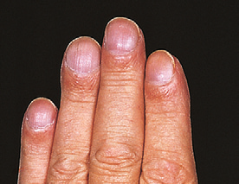
Clubbing: 1.loss of angle 2.increase curvature 3.flactuation 4.drum stick

Slide 7
Investigations
■ Sputum examination with culture & sensitivity is essential for adequate treatment.
The major pathogens are:
Staph. Aureus
Pseudomonas aeruginosa
H. influenzae and anaerobes
Strep. pneumoniae & Klebsiella pneumoniae.
Aspergillus fumigatus 10% of sputum (cystic fibrosis)
Mycobacterium avium-intracellulare complex (MAI) is being increasingly found.
■Chest X-ray: normal
dilated bronchi with thickened bronchial walls
multiple cysts containing fluid.
■ High-resolution CT scanning (sensitivity of 97%)
bronchial dilatation,
bronchial wall thickening
cysts at the end of the bronchioles

Slide 8
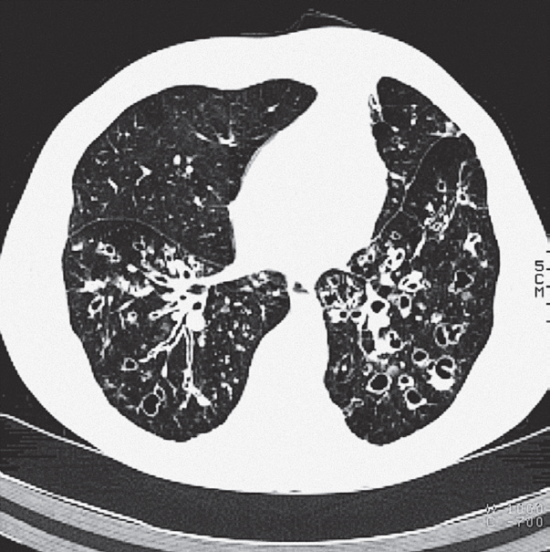
Bronchiectasis: CT scan

Slide 9
0ther investigations
■ Sinus X-rays 30% have concomitant rhino sinusitis
■ Serum immunoglobulins 10% of adults antibody deficiency ( IgA)
■ Sweat electrolytes test – if cystic fibrosis is suspected
■ Mucociliary clearance (nasal clearance of saccharin)
A 1 mm cube of saccharin is placed on the inferior turbinate and the time to taste measured (normally less than 20 minutes).

Slide 10
Management:
to enhance airway patency
Inhaled bronchodilators & Corticosteroids
Physiotherapy
regular daily physiotherapy to assist the drainage of excess bronchial
secretions, TO
reducing the amount of sputum
preventing recurrent episodes of broncho-pulmonary infection

Slide 11
Antibiotic therapy
For most patients
larger doses & longer courses are required
resolution of symptoms is often incomplete
When secondary infection with staphylococci & Gram-negative bacilli, Pseudomonas , antibiotic therapy should be guided by the microbiological sensitivities.
For Pseudomonas oral ciprofloxacin (500–750 mg twice daily) or
ceftazidime by IV injection or infusion (1–2 g 3 times daily)
Haemoptysis
often responds to treatment of the underlying infection
in severe cases, percutaneous embolisation of the bronchial circulation

Slide 12
Surgical treatment
only indicated in a small no. of cases.
if the bronchiectasis is confined to a single lobe or segment on CT
many of the patients in whom medical treatment proves unsuccessful are also unsuitable for surgery because of either
extensive bilateral bronchiectasis or
coexisting severe airflow obstruction.
In progressive forms of bronchiectasis,
resection of destroyed areas of lung that are acting as a reservoir of infection should only be considered as a last resort.

Slide 13
Prognosis
The disease is progressive when associated with ciliary dysfunction and cystic fibrosis, and eventually causes respiratory failure.
In other, the prognosis can be relatively good if physiotherapy is performed regularly and antibiotics are used aggressively.
Prevention
adequate prophylaxis for and treatment of :
childhood measles
whooping cough
primary tuberculous infection are essential
The early recognition and treatment of bronchial obstruction .

Slide 14
Occupational Lung Disease Exposure to dusts, gases, vapours and fumes at work can cause several different types of lung disease:
■ acute bronchitis, pulmonary oedema from irritants (sulphur dioxide)
■ pulmonary fibrosis mineral dust
■ occupational asthma (developed world)
■extrinsic allergic alveolitis (organic dust)
■ bronchial carcinoma (e.g. asbestos ).
mesotheloma

Slide 15
Extrinsic allergic alveolitis Hypersensitivity pneumonitis (HP)
HP; results from the inhalation of a wide variety of organic antigens, Lead to a diffuse immune complex reaction in the alveoli and bronchioles.
Common causes :
farmer’s lung and bird fancier’s lung.
HP is not exclusively occupational or environmental, & other important causes include medications

Slide 16
Extrinsic Allergic Alveolitis (HP)
In this disease there is a widespread diffuse inflammatory reaction in both the small airways of the lung and the alveoli
It is due to the inhalation of a number of different antigens, the most common being microbial spores contaminating vegetable matter (e.g. straw, hay, mushroom compost)

Slide 17
By far the most common of these diseases world-wide is farmer's lung.
farmer’s lung, which affects up to 1 in 10 of the farming community around the world.
Cigarette smokers have a lower risk of developing the disease due to decreased antibody reaction to the antigen.

Slide 18
Clinical features
Typically fever, malaise, cough, shortness of breath, several hours after exposure to the causative antigen(farmer forking hay in the morning)
may notice symptoms during the late afternoon and evening with resolution by the following morning.
On examination, the patient may have a:
fever, tachypnea.
coarse end-inspiratory crackles
wheezes throughout the chest
Cyanosis caused by V/P mismatch may be severe even at rest
Continued exposure leads to a chronic illness characterized by
severe weight loss, effort dyspnoea and cough as well as
the features of idiopathic pulmonary fibrosis .

Slide 19
Investigations
■ Chest X-ray shows fluffy nodular shadowing with the subsequent development of streaky shadows, particularly in the upper zones. In very advanced cases, honeycomb lung occurs.
■ High-resolution CT shows reticular and nodular changes with ground glass opacity,
■ Lung function tests show a restrictive ventilatory defect.
■ Polymorphonuclear leucocyte count is raised in acute cases. Eosinophilia is not a feature.
■ Precipitating antibodies are present in the serum.
Precipitating antibodies are evidence of exposure, not disease.
■ Bronchoalveolar lavage shows increased T lymphocytes and granulocytes.

Slide 20
Managements
Prevention is achieved by:
changes in work practice, with the use of silage for animal fodder and the drier storage of hay & grain. Pigeon fancier’s lung is more difficult to control (hobby).
Prednisolone, initially in large doses of 30–60 mg daily, may achieve regression during the early stages of the disease.
Established fibrosis will not resolve and in some patients the disease may progress to respiratory failure in spite of intensive therapy. .

Slide 21
Management
If practical, the patient should:
cease exposure to the inciting agent.
Dust masks with appropriate filters may minimise exposure
methods of reducing levels of antigen (e.g. drying hay before storage).
In acute cases :
prednisolone should be starting with an oral dose of 40 mg/day given for 3–4 weeks
Severely hypoxemic require high concentration oxygen
If fibrosis may progress to cause severe:
respiratory disability,
hypoxaemia,
pulmonary hypertension
cor pulmonale and eventually death

